Slide 1

AMSTer : SAR & InSAR Automated Mass processing Software for Multidimensional Time series
Nicolas d’Oreye^{1,2}, Dominique Derauw^{3,4}, Sergey Samsonov⁵,
Delphine Smittarello¹, Maxime Jaspard¹, Gilles Celli¹
ndo@ecgs.lu
amster@ecgs.lu
1 European Centre for Geodynamics and Seismology (ECGS), 19 rue Josy Welter, L-7256 Walferdange, Luxembourg
2 National Museum of Natural History (NMNH), 19 rue Josy Welter, L-7256 Walferdange, Luxembourg
3 Centre Spatial de Liège (CSL), Avenue du Pré Aily, B-4031 Angleur, Belgium
4 SAREOS, 1 Rue des Violettes, 4557 Fraiture, Belgium
5 Canada Centre for Mapping and Earth Observation, Natural Resources Canada (NRCAN), 560 Rochester Street, Ottawa, ON K1A 0E4, Canada

Slide 2
Hands-on exercise 1:
Single Pair processing for defo or topo.
Nicolas d’Oreye

Slide 3
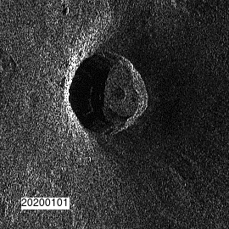

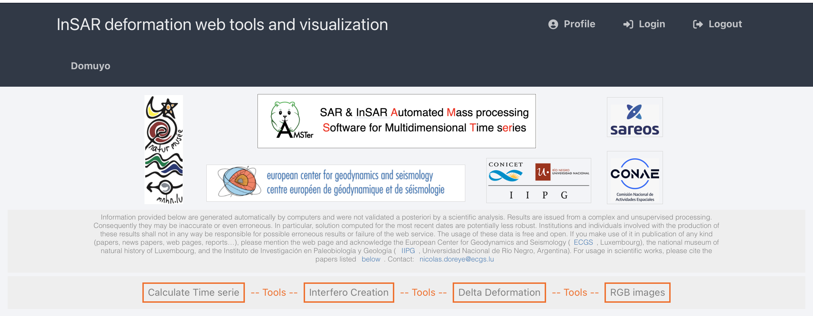
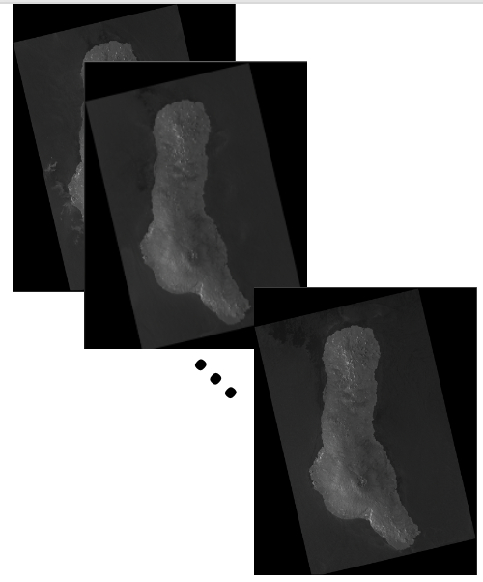
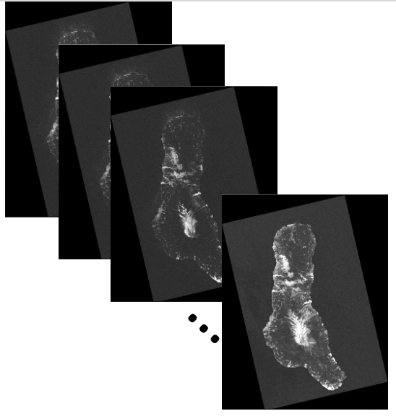
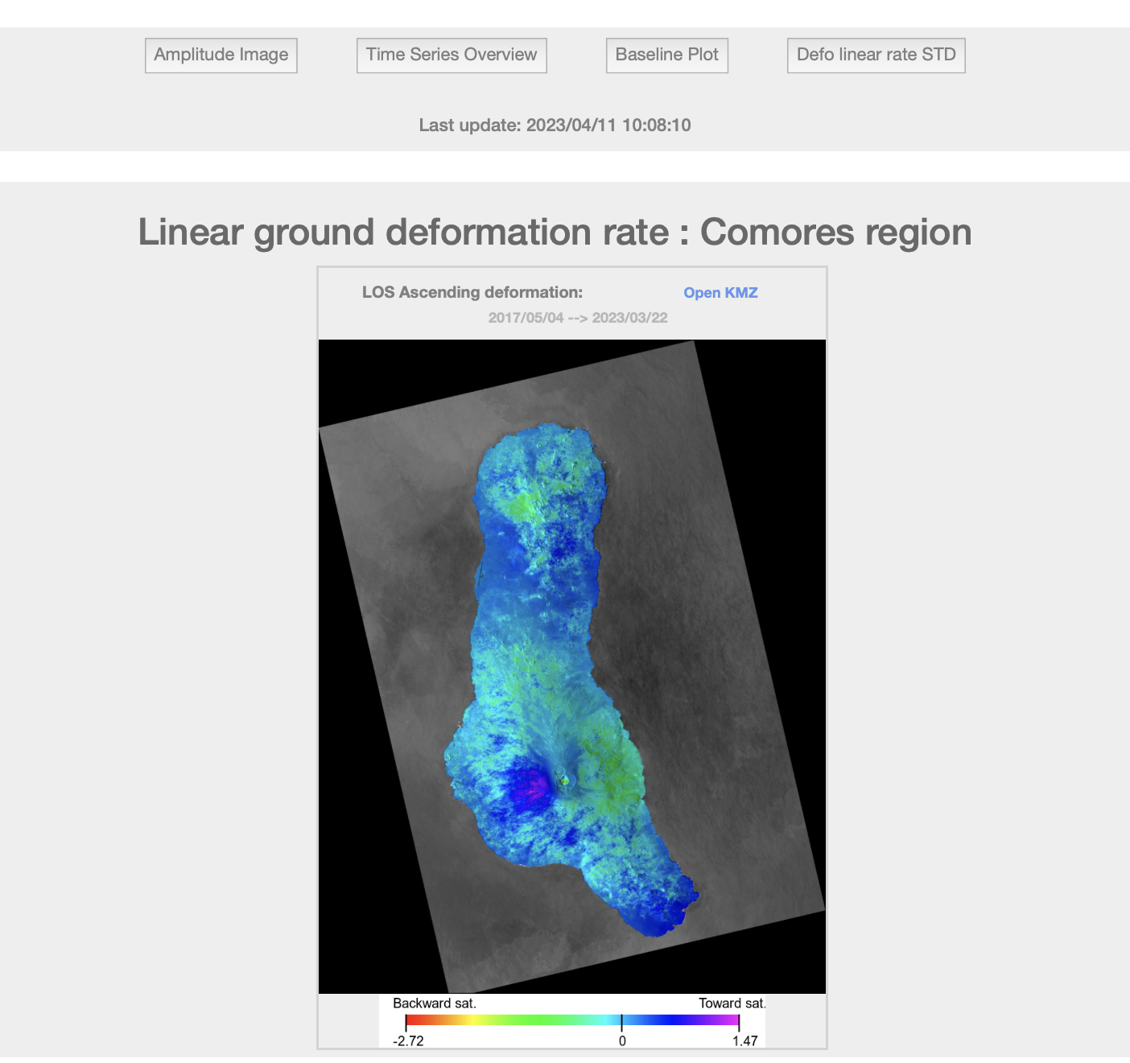
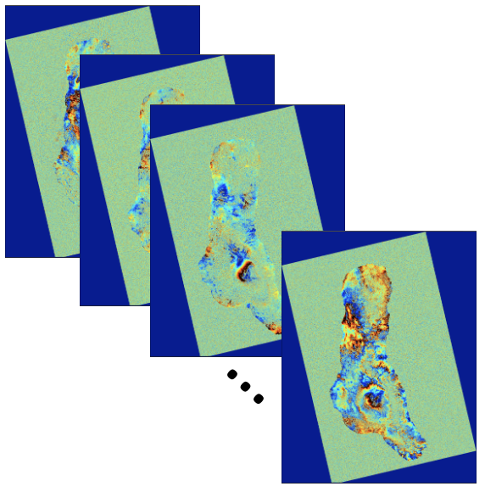
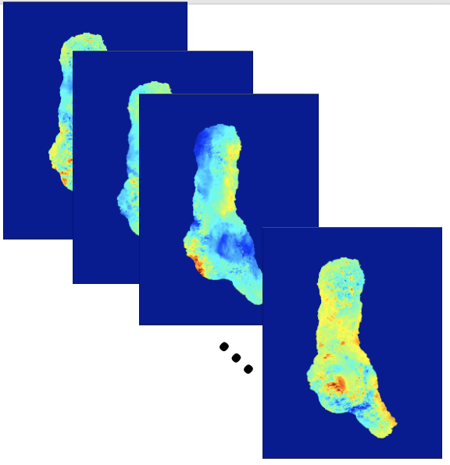
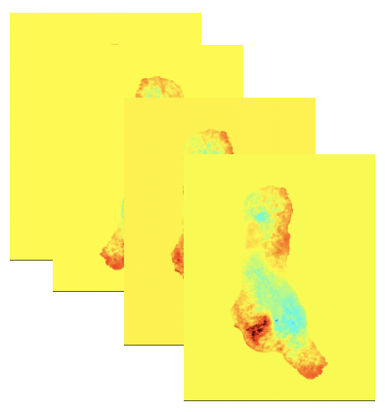
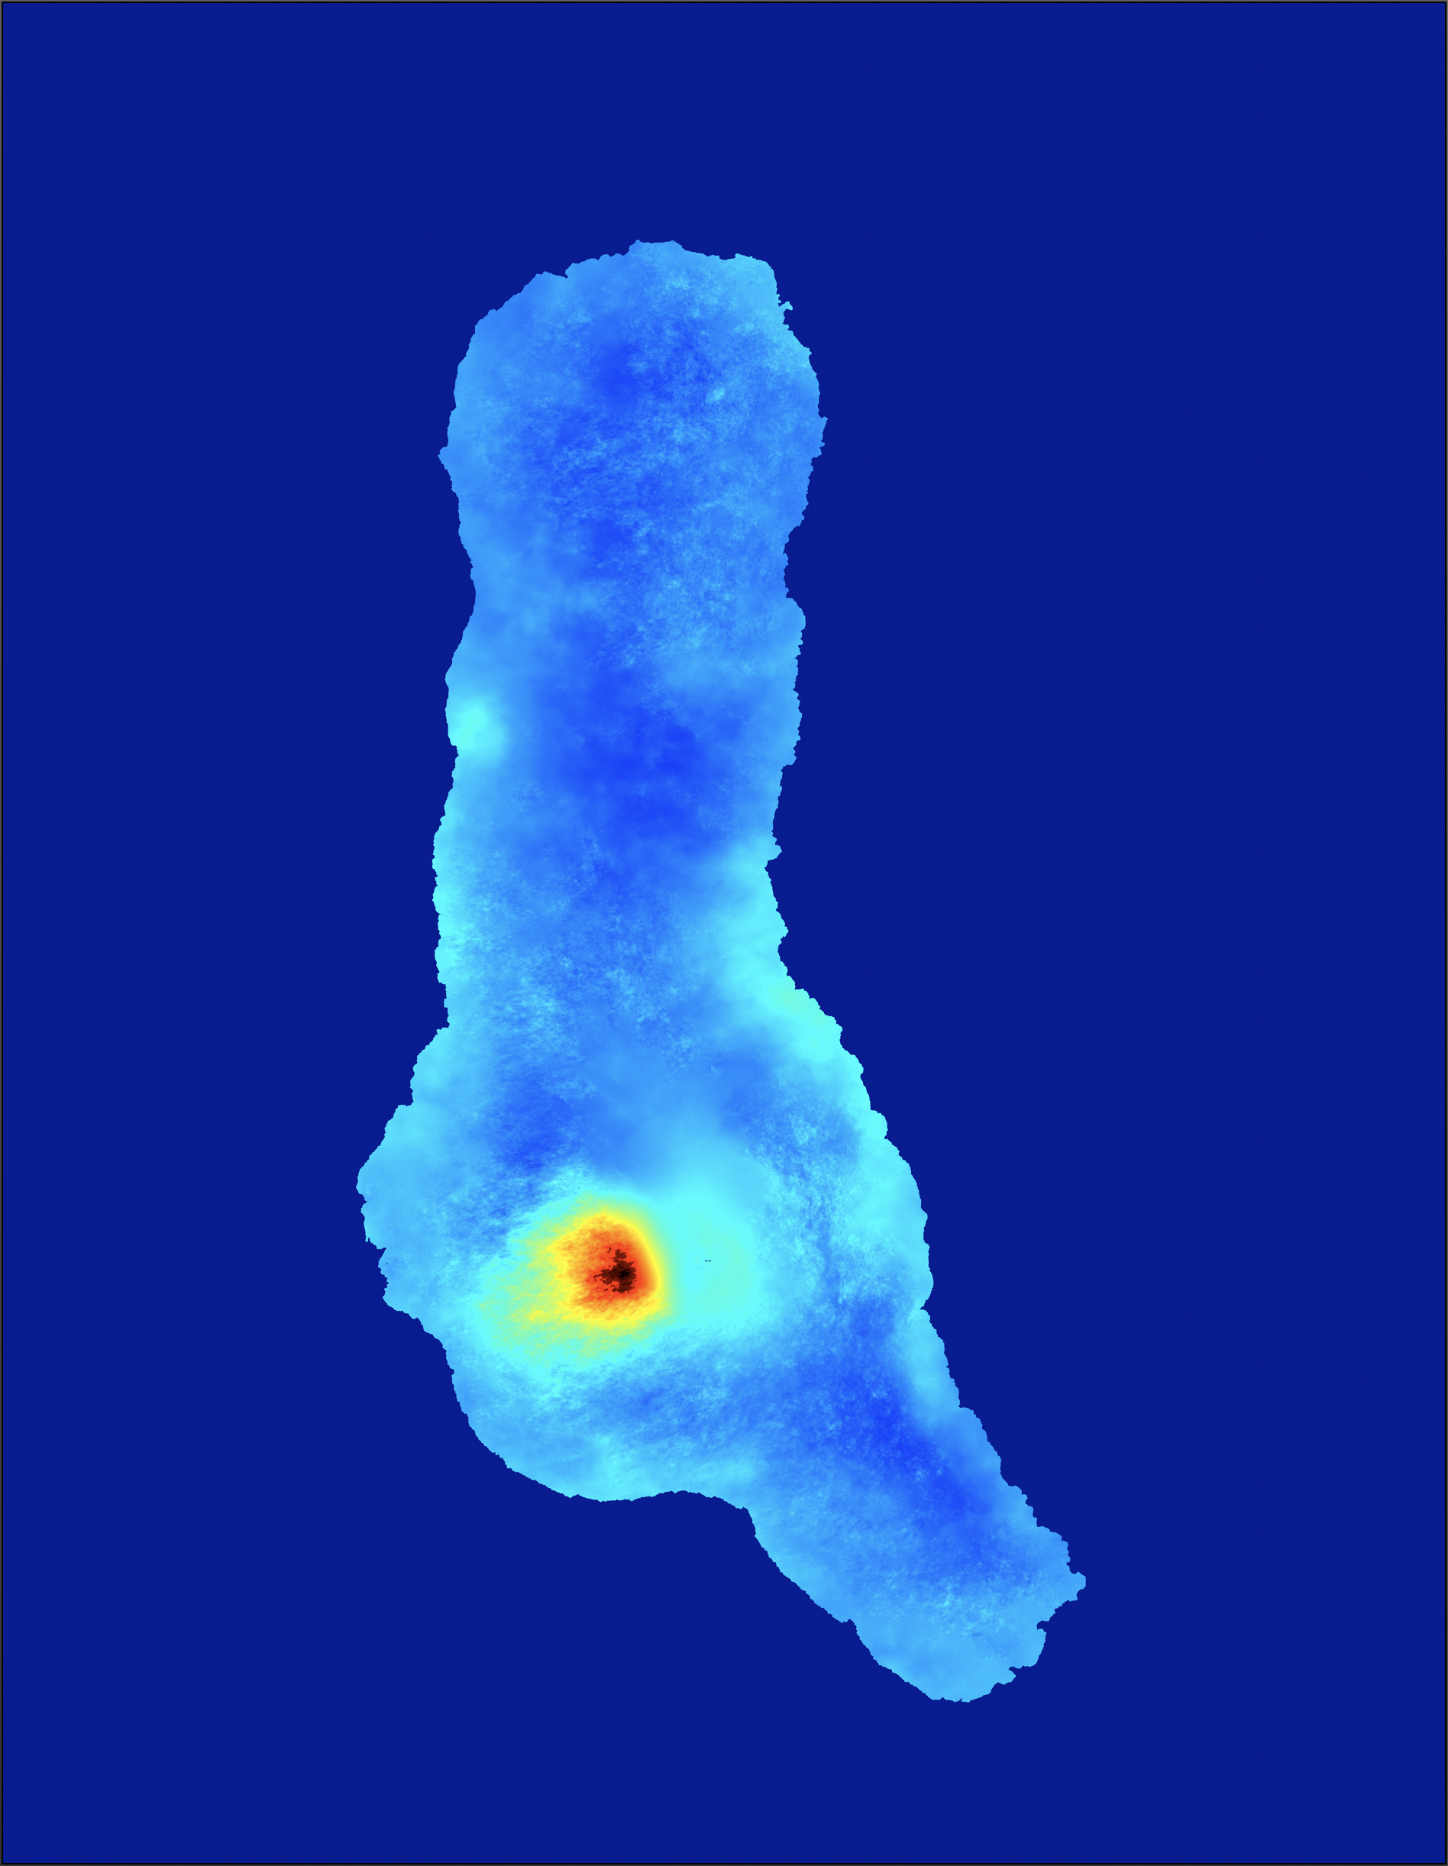
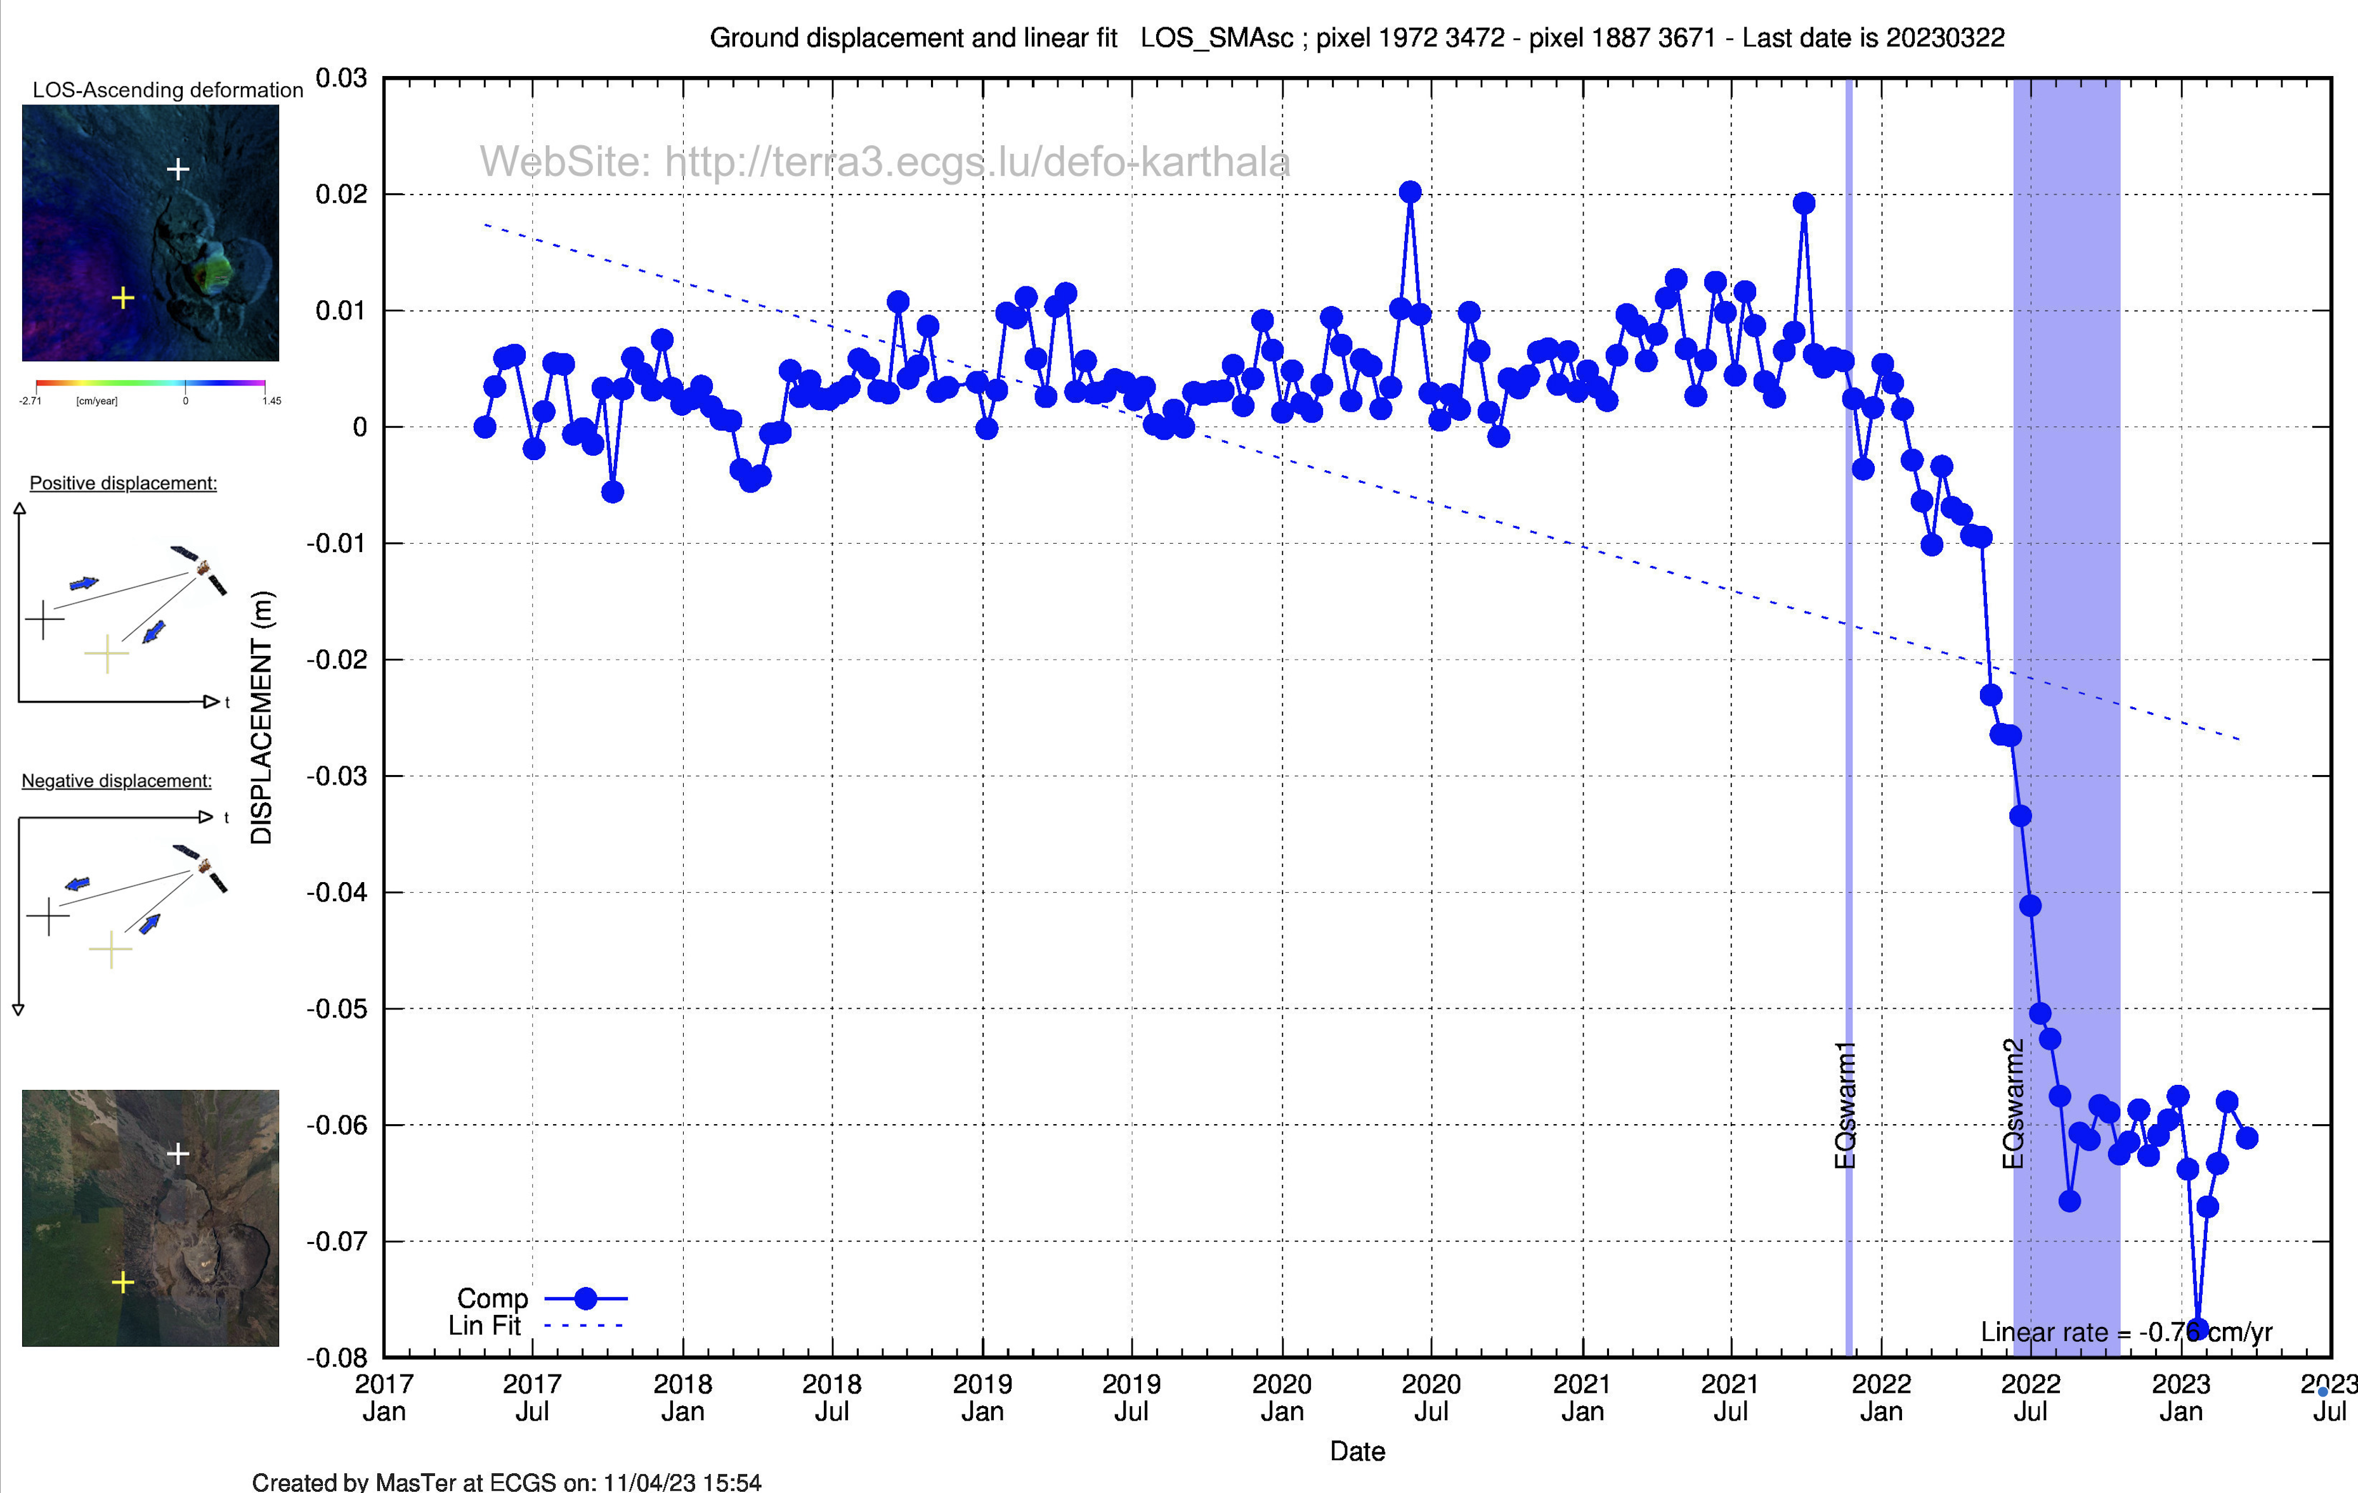
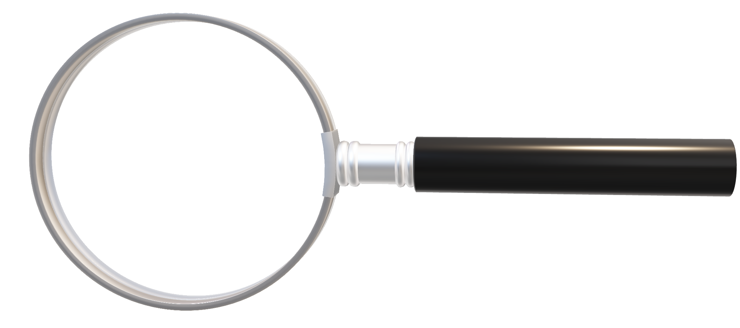
AMSTer Toolbox
Sat. image
Download
Web Page(s)
Interferometric processing
(AMSTer Engine)
Ampli.
Coh.
Time Series processing
(MSBAS)
Ampli.
Defo.
Mean Veloc.
Interf.
Cumul. defo.
Defo.
Time series
SinglPair.sh
G. Celli
D. Derauw
S. Samsonov
M. Jaspard
N. d’Oreye & D. Smittarello

Slide 4
Exercise 1
Plan:
Exercise part 1: DEFO mode using Sentinel-1 data in StripMap mode – Piton de la Fournaise
Prepare the data:
Prepare a kml (or get it from 1650)
Prepare the DEM (or get it from DataSAR)
Get the raw data e.g. from ESA SciHub portal (or get it from 3600)
Get the orbits & Read the S1 SM data (Réunion Island) with Read_All_Img.sh
Prepare the parameters file
Execute SinglePair.sh
Make a mask for water body
Reprocess with mask
Exercise part 2: TOPO mode using TDX in pursuit/bistatic mode using CIS unwrapping – Virunga or CSK using snaphu unwrapping
Prepare the data:
Get the raw data from 3600
Read the data with Read_All_Img.sh
Prepare the parameters file
Execute SinglePair.sh

Slide 5
Exercise 1 – part 1 (defo)
Exercise part 1: DEFO mode using Sentinel-1 data in StripMap mode – Piton de la Fournaise
Prepare the data:
Prepare a kml (or get it from …/1650/kml/Reunion/Reunion_Island.kml *) Prepare/check with Google Earth…. ➔ OK? ✅
Prepare the DEM (or get it from …/DataSAR/SAR_AUX_FILES/DEM/SRTM30/ALL/Reunion) ➔ OK? ✅
Get the raw data e.g. from ESA SciHub portal https://scihub.copernicus.eu/dhus/#/home (need login!) or using AMSTer Engine function S1DataDownloader (or get it from …/3600/SAR_DATA/S1/S1-DATA-REUNION_SM-SLC.UNZIP[_FORMER]) ➔ OK? ✅
* Take it from Lacie-Data because it was not in distributed dataset

Slide 6

Exercise 1 – part 1 (defo)
Exercise part 1: DEFO mode using Sentinel-1 data in StripMap mode – Piton de la Fournaise
Prepare the data:
Get the orbits & Read the S1 SM data (Réunion Island) with Read_All_Img.sh (See manual §2):
Read_All_Img.sh DirWhereRaw DirWhereCSL/NoCrop SAT PATH/kml POL [WhereRESAMP WhereMassProces ForceAllYears] where: DirWhereRaw = …/SAR_DATA/S1/S1-DATA-REUNION_SM-SLC.UNZIP DirWhereCSL/NoCrop = …/SAR_CSL/S1/PF_SM/NoCrop (will be created; beware to end with NoCrop !) SAT = S1 PATH/kml = …/kml/Reunion/Reunion_Island.kml POL = VV (see e.g. /annotation/*.xml file) ➔ OK? ✅ (~5 min?) See in …/SAR_CSL/S1/PS_SM_A_144/NoCrop Notes: - add “-n” to skip updating the orbits - add “ForceAllYears” to read data older than 6 months (if already read once, ie not anymore in 3600/SAR_DATA/S1/S1-DATA-REUNION_SM-SLC.UNZIP) - WhereRESAMP & WhereMassProces can be ignored here because no mass process is performed - Only the 3 first parameters must be provided in the right order
If you need InSAR, MasTer it
Luxembourg, May 22-26, 2023

Slide 7
Exercise 1 – part 1 (defo)
Exercise part 1: DEFO mode using Sentinel-1 data in StripMap mode – Piton de la Fournaise
Prepare the data:
Prepare the parameters file:
Copy …/SAR/AMSTer/SCRIPTS_MT/___V20221026_LaunchMasTerParam.txt in …/DataSAR/Param_files/S1/PF_SM_A_144 and name it as something useful, e.g. LaunchMTparam_S1_SM_Asc_144_Zoom1_ML8_Defo.txt (name should help to assess what it is supposed to do)
Edit it and change appropriate values
Line 18: TRKDIR must be set to PF_SM_A_144 (because that is where data are in …/SAR_CSL/S1/)
Line 22: ignore for now
Line 27: DEMNAME must be set to Reunion (because that is the name of your DEM)
Line 29: if RECOMPDEM is set to KEEP but DEM in master slant range geometry does not exist yet, it will compute it. If it exists, it will skip that step. If you need to force recomputing the DEM in slant range (e.g. if you change the DEM), then set it to FORCE. DEM in slant range is in …/SAR_CSL/S1/PF_SM_A_144/YourCrop/master.csl/Data/externalSlantRangeDEM
Line 35: set CROP to CROPyes then provide the coordinates in lines 36-39 resp.: 55.2, -21.41, 55.85 and -20.85
Line 40: keep zoom 1 (unless you want to oversample the data e.g. to reduce speckel in amplitude images)
Line 41: provide with a name that explains your (cropped) region as it will be used in dir naming, e.g. Reunion

Slide 8
Exercise 1 – part 1 (defo)
Exercise part 1: DEFO mode using Sentinel-1 data in StripMap mode – Piton de la Fournaise
Prepare the data:
Prepare the parameters file:
Edit it and change appropriate values (continue)
Lines 45 to 60 can remain as it is. These default parameters should be ok
Line 64: PROCESSMODE must be set to DEFO
Line 65: INITPOL is VV (cfr e.g. …/SAR_CSL/S1/PF_SM_A_144/NoCrop/YourImg.csl/Info/SLCImageInfo.txt)
Lines 66-67 can be ignored (only when using e.g. ALL2GIF.sh; see manual)
Line 69: INTERFML can be set to 8 (you can try higher resolution by setting it to less; remember to change the name of your param file accordingly)
Lines 70-71 are for the filtering. 1 and 1 should be OK (stronger may introduce artifacts)
Line 72: COHESTIMFACTOR must be similar to INTERFML when small and not higher than 5 or 7. Try 4 here.
Line 77: set APPLYMASKno if you do not have one yet (or APPLYMASKyes if you want to use the one provided and which you will provide with the full path at the next line, e.g. .../DataSAR/SAR_AUX_FILES/MASKS/WaterBodies/Reunion/Reunion_mask_Byte)
Line 85: SKIPUW: set it to SKIPno if you want to unwrap and compute the deformation map, or SKIPyes if you want a quick computation e.g. to get the material to compute a mask. Try SKIPyes first.
Lines 88-118 can be kept by default most of the time when performing unwrapping.

Slide 9
Exercise 1 – part 1 (defo)
Exercise part 1: DEFO mode using Sentinel-1 data in StripMap mode – Piton de la Fournaise
Prepare the data:
Prepare the parameters file:
Edit it and change appropriate values (continue)
Line 120: INTERPOL can be set to BOTH when performing unwrapping. Useless if no unwrap.
Line 1121: REMOVEPLANE: can be set to DETREND when performing unwrapping. Useless if no unwrap.
Line 126: GEOCMETHD: set it to Closest to get the coordinates of the geocoded products (size of geocoded pixels will be as close as possible as in slant range on flat topo; corners will be adjusted to extend of image). Ignore lines till 144. When performing time series, use Forced and set below the size of the geocoded pixels and corners of image accordingly.
Set the paths in the last lines:
Where do you want to perform the computation (e.g. …/PROCESS)
Where are the data in CSL format
Where is the DEM
Where is FUNCTIONS_FOR_MT.sh
Where are the RESAMPLED images (that is the coregistered on a Super Master) (if applicable)
Where are stored the resuts of the Mass Processing (if applicable)
When done, if needed, compare your LaunchMTparam_S1_SM_Asc_144_Zoom1_ML8_Defo.txt with existing example in …/SAR_AUX_FILES/Param_files/S1/PF_SM_A_144/

Slide 10
Exercise 1 – part 1 (defo)
Exercise part 1: DEFO mode using Sentinel-1 data in StripMap mode – Piton de la Fournaise
Prepare the data:
Prepare the parameters file
Execute SinglePair.sh: SinglePair.sh DateMas DateSLV ParamFile Comment [SuperMaster] where: DateMas = the date (or S1 name) of the Master image, i.e. 20210330 (or S1B_144_20210330_A) DateSLV = the date (or S1 name) of the Slave image, i.e. 20210411 (or S1B_144_20210411_A) ParamFile = path to your parameter file (LaunchMTparam_S1_SM_Asc_144_Zoom1_ML8_Defo.txt) Comment = for dir naming (useful when performing several tests…), e.g. _Closest_NoUnwrap
Notes: - it will talk and ask you if you want spare time by benefitting from possible coregistration on a super master. Answer “n” because you have no coregistration on a super master yet. If you wanted to benefit from that option, you must have provided the 5th param with the date of the Super Master
➔ OK? ✅ (~ 3 min for DEM + 15 min) See in …/PROCESS/S1/PS_SM_A_144/
Notes:
See the file naming of results in slant range and geocoded
Can’t run twice a process
Beware of path when moving results
Possible to make iterative unwrapping

Slide 11
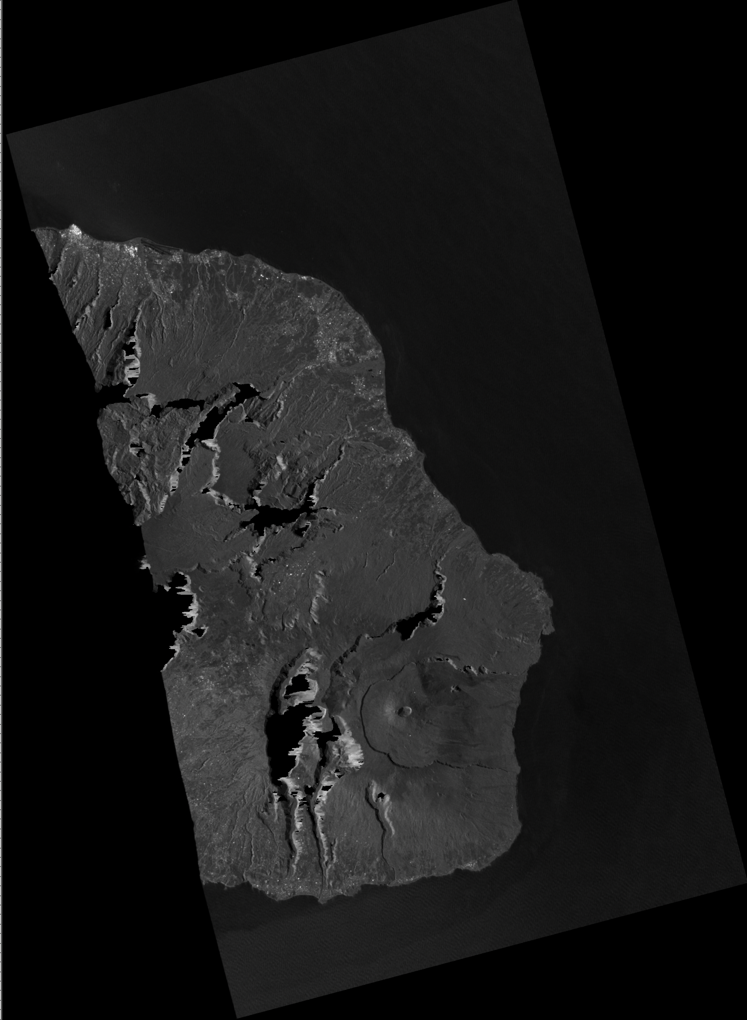
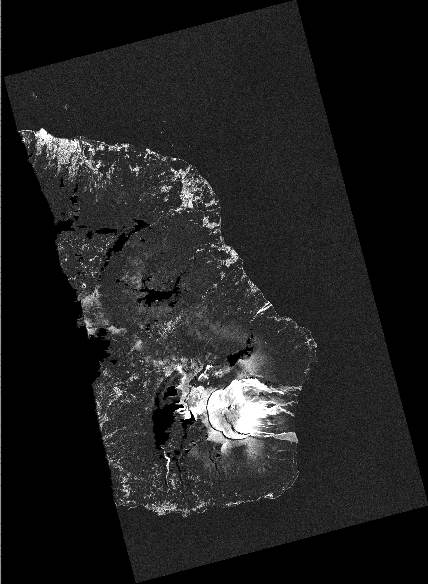
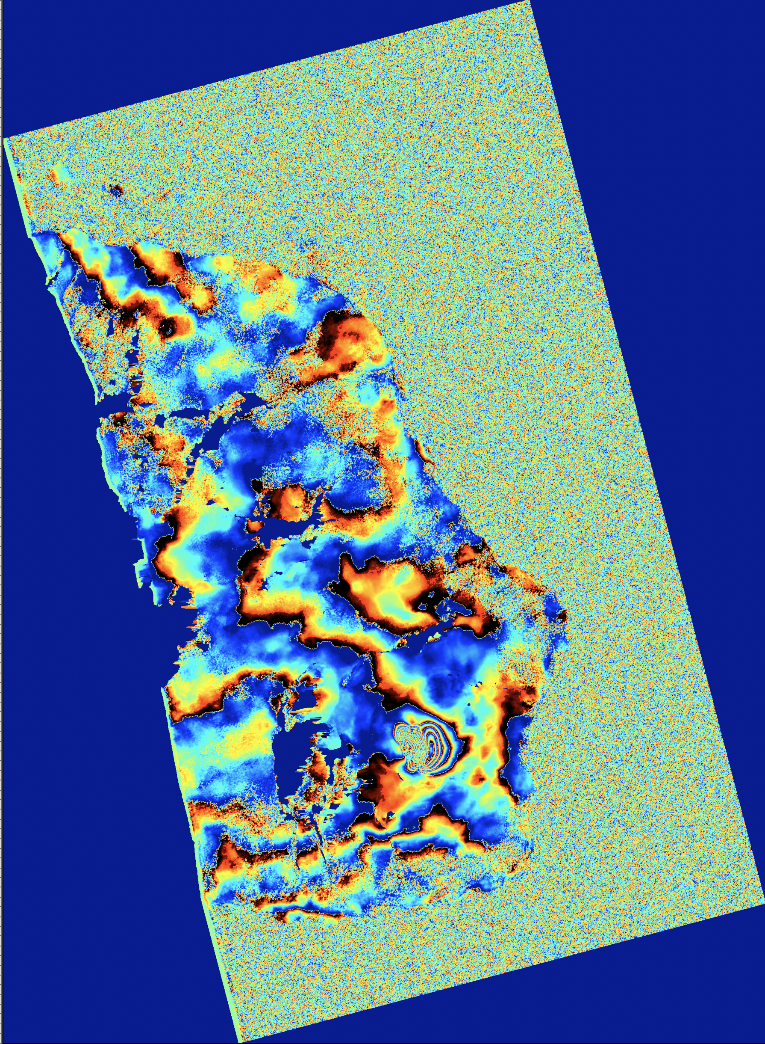
Exercise 1 – part 1 (defo)
Exercise part 1: DEFO mode using Sentinel-1 data in StripMap mode – Piton de la Fournaise
Prepare the data:
Prepare the parameters file
Execute SinglePair.sh:
Results:
Ampli
Coh
Filtered interf.

Slide 12
Exercise 1 – part 2a (topo TDX with CIS)
Exercise part 2: TOPO mode using TDX in pursuit/bistatic mode – Virunga
Prepare the data:
Get the raw data from …/3600/SAR_DATA/TDX/RDC_NYIGO_NYAM_StMp_Desc92_Bistat_150Mhz/
Read the data with Read_All_Img.sh (See manual §2):
Read_All_Img.sh DirWhereRaw DirWhereCSL/NoCrop SAT where: DirWhereRaw = …/3600/SAR_DATA/TDX/RDC_NYIGO_NYAM_StMp_Desc92_Bistat_150Mhz DirWhereCSL/NoCrop = …/SAR_CSL/TDX/RDC_NYIGO_NYAM_StMp_Desc92/NoCrop (will be created; beware to end with NoCrop !) SAT = TDX ➔ OK? ✅ (~2 min) See in …/SAR_CSL/TDX/…/NoCrop Notes: - Data will be saved as TX and RX in dedicated directories …/SAR_CSL/TDX/RDC_NYIGO_NYAM_StMp_Desc92_150Mhz_BS_D_003_RX …/SAR_CSL/TDX/RDC_NYIGO_NYAM_StMp_Desc92_150Mhz_BS_D_003_TX

Slide 13
Exercise 1 – part 2a (topo TDX with CIS)
Exercise part 2: TOPO mode using TDX in pursuit/bistatic mode – Virunga
Prepare the data:
Prepare the parameters file
Copy …/SAR/AMSTer/SCRIPTS_MT/___V20221026_LaunchMTparam.txt in …/DataSAR/Param_files/TDX/RDC_NYIGO_NYAM_StMp_Desc92_Bistat_150Mhz and name it as something useful, e.g. LaunchMTparam_TDX_SM_Desc_92_Bis_Nyigo_Nyam_Full_Zoom1_ML20_TOPO_CIS.txt (name should help to assess what it is supposed to do)
Edit it and change appropriate values
Line 18: TRKDIR must be set to RDC_NYIGO_NYAM_StMp_Desc92_150Mhz_BS_D_003_TX (because data are in such a dir)
Line 22: ignore for now
Line 27: DEMNAME; although it is computing topo, it will need and external DEM to geocode it (and assist its unwrapping)
Line 35: set CROP to CROPno Copernicus_DSM_E27-31_S00-04.tif_flip0.BIL_CorrGeoid
Line 40: keep zoom 1 (unless you want to oversample the data e.g. to reduce speckel in amplitude images)
Line 41: provide with a name that explains your (full) region as it will be used in dir naming, e.g. Full_Nyigo_Nyam
Line 64: PROCESSMODE must be set to TOPO
Line 65: INITPOL is VV (cfr e.g. …/SAR_CSL/TDX/YourMode/NoCrop/YourImg.csl/Info/SLCImageInfo.txt)
Line 69: INTERFML can be set to 20 (or higher if you want…)
Line 72: COHESTIMFACTOR must be similar to INTERFML when small and not higher than 5 or 7. Try 7 here.

Slide 14
Exercise 1 – part 2a (topo TDX with CIS)
Exercise part 2: TOPO mode using TDX in pursuit/bistatic mode – Virunga
Prepare the data:
Prepare the parameters file
Edit it and change approprite values (continue)
Line 77: set APPLYMASKno if you do not have one yet or do not want one. To mask water bodies, set it to APPLYMASKyes and provide with the full path at the next line, e.g. the provided one: .../DataSAR/SAR_AUX_FILES/MASKS/WaterBodies/DRCongo/LakeKivu_LatLong.
Line 85: SKIPUW: set it to SKIPno
Line 86: UWMETHOD, try CIS
Lines 88-118 can be kept by default most of the time when performing unwrapping.
Line 120: it is not advised to process interpolation when computing DEM, hence set INTERPOL to NONE
Line 121: REMOVEPLANE: it is not advised to process a detrending when computing DEM. Set it to DETRENDno
Line 126: GEOCMETHD: set it to Closest
Set the paths in the last lines as before…
When done, if needed, compare your LaunchMTparam_TDX_SM_Desc_92_Bis_Nyigo_Nyam_Full_Zoom1_ML20_TOPO_CIS.txt with existing example in …/DataSAR/Param_files/TDX/RDC_NYIGO_NYAM_StMp_Desc92_Bistat_150Mhz

Slide 15
Exercise 1 – part 2a (topo TDX with CIS)
Exercise part 2: TOPO mode using TDX in pursuit/bistatic mode – Virunga
Prepare the data:
Prepare the parameters file
Execute SinglePair.sh
SinglePair.sh DateMas DateSLV ParamFile Comment [SuperMaster] where: DateMas = the date of the Master image, i.e. 20140912 DateSLV = the date of the Slave image, i.e. 20140912 ParamFile = path to your parameter file (LaunchMTparam_TDX_SM_Desc_92_Bis_Nyigo_Nyam_Full_Zoom1_ML20_TOPO_CIS.txt) Comment = for dir naming (useful when performing several tests…), e.g. _CIS_Unwrap
Notes: - Note how SLV was renamed with dummy name (year 9000) to avoid conflict with same name as MAS image. A link was also created from RX to TX with the dummy date for processing infrastructure requirments
- geocoded DEM is named “slantRangeDEM.VV-VV.UTM.40x40.bil_TDX_RDC_NYIGO_NYAM…”
- remember to track errors or warnings by looking at lines that do not start with “ //”. You can ignore the errors about flipped or flopped mod file not found.
➔ OK? ✅ (~ 1 min for DEM + 8 min) See in …/PROCESS/TDX/…

Slide 16
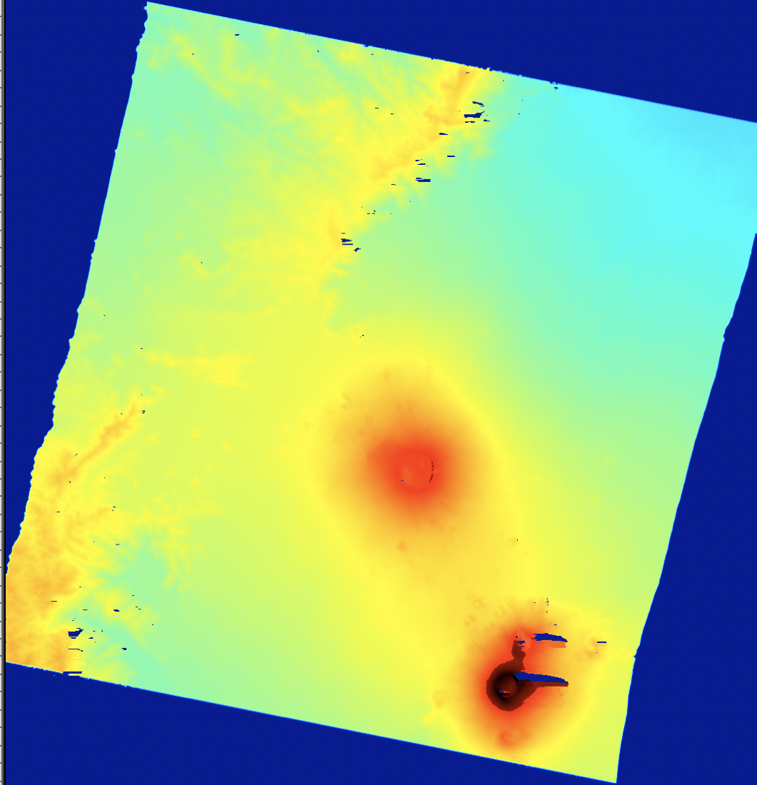
Exercise 1 – part 2a (topo TDX with CIS)
Exercise part 2: TOPO mode using TDX in pursuit/bistatic mode – Virunga
Prepare the data:
Prepare the parameters file
Execute SinglePair.sh
Results:
Slant Range DEM

Slide 17
Exercise 1 – part 2b (topo CSK with snaphu)
Exercise part 2: TOPO mode using CSK – Virunga
Prepare the data:
Get the raw data from …/3600/SAR_DATA/CSK/VVP/
Read the data with Read_All_Img.sh (See manual §2):
Read_All_Img.sh DirWhereRaw DirWhereCSL/NoCrop SAT PATH/kml where: DirWhereRaw = …/3600/SAR_DATA/CSK/VVP DirWhereCSL/NoCrop = …/SAR_CSL/CSK/Virunga_Asc/NoCrop (will be created; beware to end with NoCrop !) SAT = CSK ➔ OK? ✅ (~2 min) See in …/SAR_CSL/CSK/…/NoCrop Notes: - name Virunga_Asc is arbitrary. We knew here it was ascending mode and targetting the Virunga, so it made sense to call it like that.
- Choose carefully your pair of images to get an appropriate baseline ! Watch the altitude of ambiguity.

Slide 18
Exercise 1 – part 2b (topo CSK with snaphu)
Exercise part 2: TOPO mode using CSK – Virunga
Prepare the data:
Prepare the parameters file
Copy …/SAR/AMSTer/SCRIPTS_MT/___V20221026_LaunchMTparam.txt in …/DataSAR/Param_files/CSK/Virunga_Asc and name it as something useful, e.g. LaunchMTparam_CSK_Virunga_Asc_Zoom1_ML30_snaphu_TOPO.txt (name should help to assess what it is supposed to do)
Edit it and change appropriate values
Line 18: TRKDIR must be set to Virunga_Asc (because data are in such a dir)
Line 22: ignore for now
Line 27: DEMNAME; although it is computing topo, it will need and external DEM to geocode it (and assist its unwrapping)
Line 35: set CROP to CROPno
Line 40: keep zoom 1 (unless you want to oversample the data e.g. to reduce speckel in amplitude images)
Line 41: provide with a name that explains your (full) region as it will be used in dir naming, e.g. Full
Line 64: PROCESSMODE must be set to TOPO
Line 65: INITPOL is HH (cfr e.g. …/SAR_CSL/CSK/Virunga_Asc/NoCrop/YourImg.csl/Info/SLCImageInfo.txt)
Line 69: INTERFML can be set to 30 (or higher if you want…)
Line 72: COHESTIMFACTOR must be similar to INTERFML when small and not higher than 5 or 7. Try 7 here.

Slide 19
Exercise 1 – part 2b (topo CSK with snaphu)
Exercise part 2: TOPO mode using CSK – Virunga
Prepare the data:
Prepare the parameters file
Edit it and change appropriate values (continue)
Line 77: set APPLYMASKno if you do not have one yet or do not want one. To mask water bodies, set it to APPLYMASKyes and provide with the full path at the next line, e.g. the provided one: .../DataSAR/SAR_AUX_FILES/MASKS/WaterBodies/DRCongo/LakeKivu_LatLong.
Line 85: SKIPUW: set it to SKIPno
Line 86: UWMETHOD, try SNAPHU
Lines 89-118 can be kept by default most of the time when performing unwrapping.
Line 120: it is not advised to process interpolation when computing DEM, hence set INTERPOL to NONE
Line 121: REMOVEPLANE: it is not advised to process a detrending when computing DEM. Set it to DETRENDno
Line 126: GEOCMETHD: set it to Closest
Set the paths in the last lines as before…
When done, if needed, compare you LaunchMTparam_CSK_Virunga_Asc_Zoom1_ML30_snaphu_TOPO.txt with existing example in …/DataSAR/Param_files/CSK/Virunga_Asc

Slide 20
Exercise 1 – part 2b (topo CSK with snaphu)
Exercise part 2: TOPO mode using CSK – Virunga
Prepare the data:
Prepare the parameters file
Execute SinglePair.sh
SinglePair.sh DateMas DateSLV ParamFile Comment [SuperMaster] where: DateMas = the date of the Master image, i.e. 20210928 DateSLV = the date of the Slave image, i.e. 20210929 ParamFile = path to your parameter file (LaunchMTparam_CSK_Virunga_Asc_Zoom1_ML30_snaphu_TOPO.txt) Comment = for dir naming (useful when performing several tests…), e.g. _snaphu_Unwrap
Notes: - answer no when it offers you to gain time by using possible results from a coregistration on a super master…
➔ OK? ✅ (~ 1 min for DEM + 25 min) See in …/PROCESS/CSK/…

Slide 21
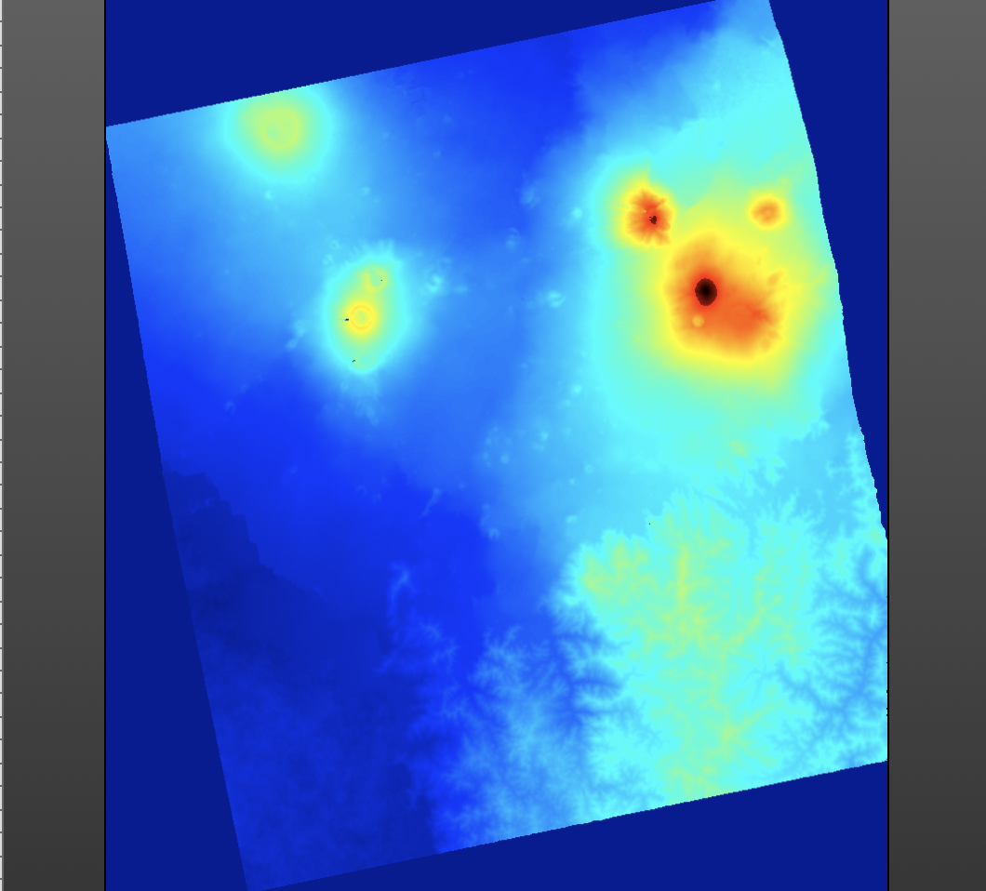
Exercise 1 – part 2b (topo CSK with snaphu)
Exercise part 2: TOPO mode using CSK – Virunga
Prepare the data:
Prepare the parameters file
Execute SinglePair.sh
Results:
Slant Range DEM

Slide 22
Exercise 1
Plan:
Exercise part 1: DEFO mode using Sentinel-1 data in StripMap mode – Piton de la Fournaise
Prepare the data:
Prepare a kml (or get it from 1650)
Prepare the DEM (or get it from DataSAR)
Get the raw data e.g. from ESA SciHub portal (or get it from 3600)
Get the orbits & Read the S1 SM data (Réunion Island) with Read_All_Img.sh
Prepare the parameters file
Execute SinglePair.sh
Make a mask for water body
Reprocess with mask
Exercise part 2: TOPO mode using TDX in pursuit/bistatic mode using CIS unwrapping – Virunga or CSK using snaphu unwrapping
Prepare the data:
Get the raw data from 3600
Read the data with Read_All_Img.sh
Prepare the parameters file
Execute SinglePair.sh
- DONE ! -

Slide 23
Data samples for exercise 2
Provide samples (S1 database info, S1 data, DEM) to participants
Empty data directories to build baseline plots: 1650/SAR_CSL/S1/ARG_DOMU_LAGUNA_A_18 /NoCrop 2.49 Gb – 18.949 items 1650/SAR_CSL/S1/ARG_DOMU_LAGUNA_D_83/NoCrop 2.61 Gb – 21.533 items
3 images for test (20210407 (=SM), 20210413 and 20210507): 1650/SAR_CSL/S1/ARG_DOMU_LAGUNA_D_83_Tst_Coreg/NoCrop 23.72 Gb – 329 items
The DEM of Domuyo – Laguna del Maule region: DataSAR/SAR_AUX_FILES/DEM/SRTM30/ALL/NQNYMAS 2.9 Gb – 1 item DataSAR/SAR_AUX_FILES/DEM/SRTM30/ALL/NQNYMAS.txt 679 b – 1 item

Slide 24
AMSTer Toolbox
Sat. image
Download
Web Page(s)
Interferometric processing
(AMSTer Engine)
Ampli.
Coh.
Time Series processing
(MSBAS)
Ampli.
Defo.
Mean Veloc.
Interf.
Cumul. defo.
Defo.
Time series
Mass processing
G. Celli
D. Derauw
S. Samsonov
M. Jaspard
N. d’Oreye & D. Smittarello

